Slide 1
Artificial Intelligence
Daniyal Saghir

Slide 2
Table of Content
Definition
History
Current Status of AI
Challenges of AI
Future of AI
Pros and Cons
Conclusion

Slide 3
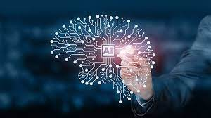
Definition
Artificial intelligence is the ability of machines to perform tasks that are typically associated with human intelligence, such as learning and problem-solving.

Slide 4
History Of AI
Dartmouth Workshop (1956): The birth of AI as a field is often traced back to the Dartmouth Workshop, organized by John McCarthy, Marvin Minsky, Nathaniel Rochester, and Claude Shannon in the summer of 1956. This workshop marked the official beginning of AI research.
AI Winter (1970s-1980s): After initial enthusiasm and high expectations, AI research went through a period known as the "AI Winter" in the 1970s and 1980s.
Deep Learning and Modern Resurgence (2010s): The 21st century has seen a remarkable resurgence of AI, largely driven by breakthroughs in deep learning. Deep learning techniques, such as convolutional neural networks (CNNs) and recurrent neural networks (RNNs), have revolutionized areas like image recognition, natural language processing, and autonomous vehicles.

Slide 5
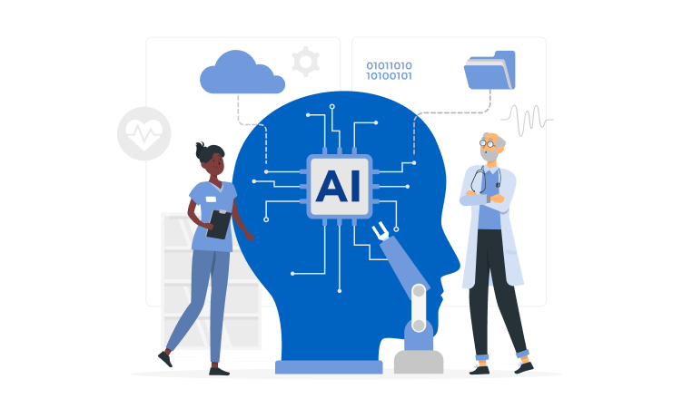
Current Status Of AI
AI is now a cornerstone in various sectors, bolstering efficiency and innovation. From healthcare and finance to customer service and transportation, organizations are leveraging AI for enhanced operations, smarter decision-making, and improved services, heralding a future of heightened automation and ingenuity.

Slide 6
Challenges of AI
Algorithmic Bias: AI can inherit biases from training data, leading to unfair outcomes. Ethical AI requires addressing bias, ensuring transparency, and accountability for fairness.
Data Privacy & Security: AI's reliance on vast data raises privacy and security concerns. Protecting sensitive data and preventing breaches is crucial for AI development.
Lack of General AI: Achieving human-level AI across diverse tasks (AGI) is a significant challenge. Developing adaptable AI with broad capabilities presents complex technical hurdles.

Slide 7
Cons Of AI
Job Displacement: AI automation can lead to job displacement, as machines and algorithms take over tasks traditionally performed by humans. This can result in unemployment and a need for reskilling.
Bias and Fairness: AI systems may inherit biases from their training data, leading to unfair or discriminatory outcomes, especially in areas like hiring, lending, and criminal justice.
Privacy Concerns: The extensive collection and analysis of personal data by AI systems can raise significant privacy concerns. Misuse of this data can lead to breaches of privacy and surveillance issues.
Security Risks: As AI systems become more sophisticated, they can also be used for cyberattacks, making it necessary to develop advanced security measures to protect against AI-driven threats.
Lack of Creativity and Empathy: AI lacks true creativity, emotions, and empathy. It cannot replicate the depth of human understanding and connection in many situations, such as customer service and healthcare.

Slide 8
Conclusion
Overall, AI holds immense promise, but responsible development, regulation, and ongoing research are essential to harness its benefits while mitigating its drawbacks. As AI technology continues to evolve, it is our collective responsibility to guide its growth in a way that aligns with our values and societal well-being.

Slide 9
Pros Of AI
Automation and Efficiency: AI can automate repetitive and time-consuming tasks, leading to increased efficiency and productivity in various industries. This allows human workers to focus on more creative and strategic aspects of their jobs.
Accuracy and Consistency: AI systems can perform tasks with a high degree of accuracy and consistency, reducing errors and improving the quality of output in fields such as manufacturing, healthcare, and finance.
Data Analysis: AI excels at analyzing vast amounts of data quickly. It can identify patterns, trends, and insights that may be difficult for humans to discern, aiding in data-driven decision-making.
24/7 Availability: AI-powered systems can operate round the clock without fatigue or breaks, providing continuous service and support, such as chatbots and virtual assistants.
Personalization: AI can personalize user experiences and recommendations based on individual preferences and behaviors, enhancing customer satisfaction in e-commerce, entertainment, and marketing.

